Slide 1
Chapter 3 – Requirements Engineering
Anh Nguyen-Duc
Tho Quan Thanh

Slide 2
Topics covered
Course’s project
Functional and non-functional requirements
Requirements engineering processes
Requirements elicitation
Requirements specification
Requirement in Agile
Requirements validation
Requirements change

Slide 3
Topics covered
Course’s project
Functional and non-functional requirements
Requirements engineering processes
Requirements elicitation
Requirements specification
Requirement in Agile
Requirements validation
Requirements change

Slide 4
Requirements

Slide 5

Effects of inadequate requirements development – Airbus
Requirement: Reverse thrust may only be used when the airplane is landed.
Translation: Reverse thrust may only be used while the wheels are rotating.
Implementation: Reverse thrust may only be used while the wheels are rotating fast enough.
Situation: Rainstorm – aquaplaning
Result: Crash due to overshooting the runway!
Problem: Erroneous in the requirement phase

Slide 6
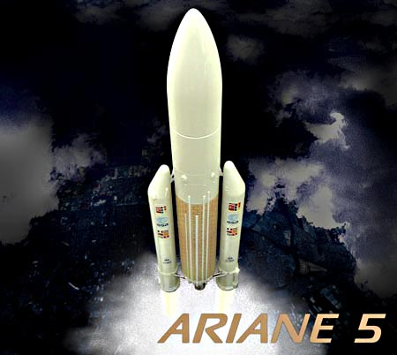
The Ariane 5 accident – 1
Single root cause failure!
The ”bug”: attitude deviation stored as 2-byte integer (max value 65,535) instead of 4-byte (max value 4,294,967,295)
SW module was reused from Ariane 4
Insufficient V&V of detailed requirements: larger attitude deviation tolerated in Ariane 5 than in Ariane 4
Ariane 5 production cost 10 years and $7 billion; luckily, no victims because it was unmanned.
65,535 = 00000000 00000000 11111111 11111111
65,536 = 00000000 00000001 00000000 00000000
Notes:
https://www.youtube.com/watch?v=gp_D8r-2hwk

Slide 7
Other software related accidents & incidents
Accidents & incidents
Alarm flooding, power distribution failure, BP Grangemouth Scotland, 29th May - 10th June 2000
failure in a data bus + faulty logic in the software => engine power loss, Airbus A340-642, 2005
failed accelerometer + software bug => Faulty airspeed metering, Boeing 777-200, 2005
Software bug => shutdown of radio communication between ATC and aircraft, 2004. disrupted 800 flights
Safety-related software flaws => recall of 200,000 pacemakers in 1990-2000
radiotherapy machines attacked by computer viruses, 2005
Buggy software incorporate computer + connection between corporate and control systems networks => shutdown of the nuclear power plant, USA 2008
Many software failures are actually ”bugs” in the detailed requirement specifications, i.e., poor understanding of the very detailed requirements
Korean Air 747 in Guam, 200 deaths (1997): incorrect configuration of ”minimum altitude” warning system

Slide 8
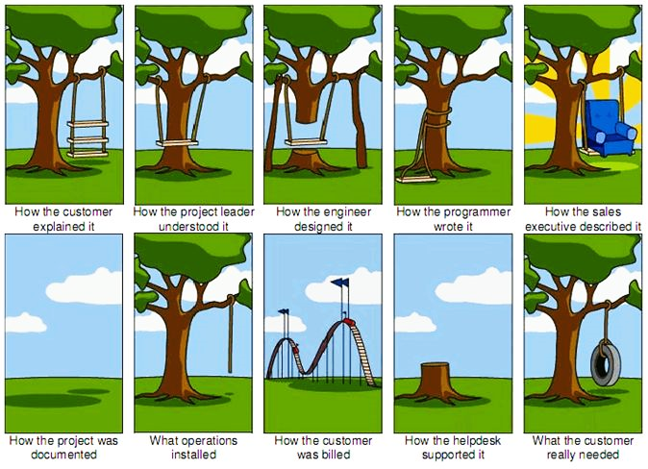

Slide 9
What is a requirement?
Requirement engineering = establishing the services that the customer requires from a system and the constraints under which it operates and is developed.
Requirement = the descriptions of
the system services
and constraints
It may range
from a high-level abstract statement
to a detailed mathematical functional specification.
May serve a dual function
The basis for a bid for a contract - must be open to interpretation;
The basis for the contract itself - must be in detail;
Notes:
The requirements themselves are the descriptions of the system services and constraints that are generated during the requirements engineering process.
It may range from a high-level abstract statement of a service or of a system constraint to a detailed mathematical functional specification.
This is inevitable as requirements may serve a dual function
May be the basis for a bid for a contract - therefore must be open to interpretation;
May be the basis for the contract itself - therefore must be defined in detail;
Both these statements may be called requirements.
Requirement abstraction guideline
Davis, A. M. (1993). Software Requirements: Objects, Functions and States. Englewood Cliffs, NJ: Prentice Hall.
“If a company wishes to let a contract for a large software development project, it must define its needs in a sufficiently abstract way that a solution is not pre-defined. The requirements must be written so that several contractors can bid for the contract, offering, perhaps, different ways of meeting the client organization’s needs. Once a contract has been awarded, the contractor must write a system definition for the client in more detail so that the client understands and can validate what the software will do. Both of these documents may be called the requirements document for the system.”

Slide 10
Topics covered
Course’s project – UWC 2.0
Functional and non-functional requirements
Requirements engineering processes
Requirements elicitation
Requirements specification
Requirements validation
Requirements change

Slide 11

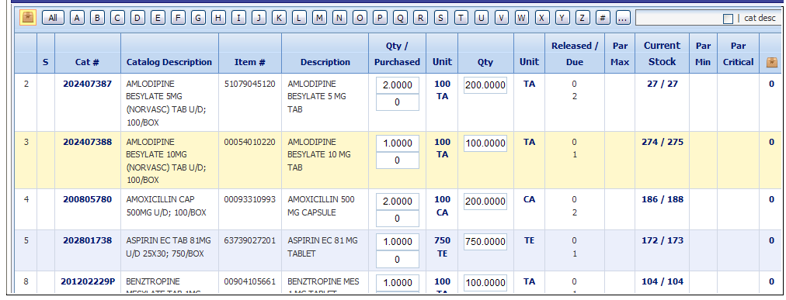
MENTCare system
Mentcare (Medical practice management system): manages the day-to-day operations of a clinic, such as appointment scheduling, billing and other administrative tasks.

Slide 12
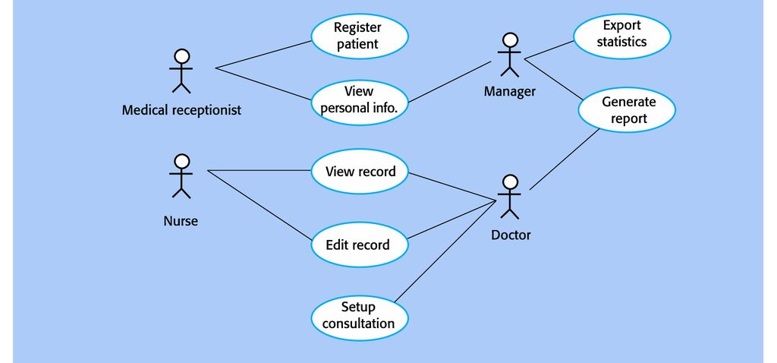
MENTCare system
Mentcare (Medical practice management system): manages the day-to-day operations of a clinic, such as appointment scheduling, billing and other administrative tasks.

Slide 13
Functional and non-functional requirements
Functional requirements
Statements of services the system should provide, how the system should react to particular inputs and how the system should behave in particular situations.
May state what the system should not do.
Non-functional requirements
Constraints on the services or functions offered by the system such as timing constraints, constraints on the development process, standards, etc.
Often apply to the system as a whole rather than individual features or services.
Domain requirements
Constraints on the system from the domain of operation
Notes:
In reality, the distinction between different types of requirement is not as clear-cut as these simple definitions suggest.
A user requirement concerned with security, such as a statement limiting access to authorized users, may appear to be a nonfunctional requirement. However, when developed in more detail, this requirement may generate other requirements that are clearly functional, such as the need to include user authentication facilities in the system.
This shows that requirements are not independent and that one requirement often generates or constrains other requirements.
The system requirements therefore do not just specify the services or the features of the system that are required; they also specify the necessary functionality to ensure that these services/features are delivered properly.

Slide 14
Functional requirements
Describe functionality or system services.
Functional user requirements may be high-level statements of what the system should do.
Functional system requirements should describe the system services in detail.
Notes:
The functional requirements for a system describe what the system should do. These requirements depend on the type of software being developed, the expected users of the software, and the general approach taken by the organization when writing requirements.
When expressed as user requirements, functional requirements are usually described in an abstract way that can be understood by system users.
However, more specific functional system requirements describe the system functions, its inputs and outputs, exceptions, etc., in detail.

Slide 15
Mentcare system: functional requirements
A user shall be able to search the appointments lists for all clinics.
The system shall generate each day, for each clinic, a list of patients who are expected to attend appointments that day.
Each staff member using the system shall be uniquely identified by his or her 8-digit employee number.
Notes:
They are all user requirements.
Note that, the user requirements should be represented in detail as system requirements. For example, the second requirement should be stated more clear and more detail such that what information about the patients should be listed, what kind of output (screen, printed paper, …), …

Slide 16
Non-functional requirements
Define system properties and constraints
Properties: reliability, response time and storage requirements.
Constraints: I/O device capability, system representations, etc.
Non-functional requirements may be more critical than functional requirements.
If these are not met, the system may be useless.
Notes:
Non-functional requirements, such as performance, security, or availability, usually specify or constrain characteristics of the system as a whole.
Process requirements may also be specified mandating a particular IDE, programming language or development method.
Non-functional requirements are often more critical than individual functional requirements. System users can usually find ways to work around a system function that doesn’t really meet their needs. However, failing to meet a non-functional requirement can mean that the whole system is unusable.
For example, if an aircraft system does not meet its reliability requirements, it will not be certified as safe for operation; if an embedded control system fails to meet its performance requirements, the control functions will not operate correctly.

Slide 17
Non-functional requirements implementation
Non-functional requirements may affect the overall architecture of a system
rather than the individual components
cross-cutting concern
A single non-functional requirement
may generate a number of related functional requirements
and may also generate requirements that restrict existing requirements.
Notes:
Although it is often possible to identify which system components implement specific functional requirements (e.g., there may be formatting components that implement reporting requirements), it is often more difficult to relate components to non-functional requirements.
The implementation of these requirements may be diffused throughout the system. There are two reasons for this:
1. Non-functional requirements may affect the overall architecture of a system rather than the individual components. For example, to ensure that performance requirements are met, you may have to organize the system to minimize communications between components.
2. A single non-functional requirement, such as a security requirement, may generate a number of related functional requirements that define new system services that are required. In addition, it may also generate requirements that restrict existing requirements.

Slide 18
Non-functional classifications
Product requirements
Requirements which specify that the delivered product must behave in a particular way e.g. execution speed, reliability, etc.
Organisational requirements
Requirements which are a consequence of organisational policies and procedures e.g. process standards used, implementation requirements, etc.
External requirements
Requirements which arise from factors which are external to the system and its development process e.g. interoperability requirements, legislative requirements, etc.
Notes:
1. Product requirements
These requirements specify or constrain the behavior of the software. Examples include performance requirements on how fast the system must execute and how much memory it requires, reliability requirements that set out the acceptable failure rate, security requirements, and usability requirements.
2. Organizational requirements
These requirements are broad system requirements derived from policies and procedures in the customer’s and developer’s organization. Examples include operational process requirements that define how the system will be used, development process requirements that specify the programming language, the development environment or process standards to be used, and environmental requirements that specify the operating environment of the system.
3. External requirements
This broad heading covers all requirements that are derived from factors external to the system and its development process. These may include regulatory requirements that set out what must be done for the system to be approved for use by a regulator, such as a central bank; legislative requirements that must be followed to ensure that the system operates within the law; and ethical requirements that ensure that the system will be acceptable to its users and the general public.

Slide 19
Examples of nonfunctional requirements in the Mentcare system
Product requirement
The Mentcare system shall be available to all clinics during normal working hours (Mon–Fri, 0830–17.30). Downtime within normal working hours shall not exceed five seconds in any one day.
Organizational requirement
Users of the Mentcare system shall authenticate themselves using their health authority identity card.
External requirement
The system shall implement patient privacy provisions as set out in HStan-03-2006-priv.
Notes:
The product requirement is an availability requirement that defines when the system has to be available and the allowed down time each day. It says nothing about the functionality of MHC-PMS and clearly identifies a constraint that has to be considered by the system designers.
The organizational requirement specifies how users authenticate themselves to the system. The health authority that operates the system is moving to a standard authentication procedure for all software where, instead of users having a login name, they swipe their identity card through a reader to identify themselves.
The external requirement is derived from the need for the system to conform to privacy legislation. Privacy is obviously a very important issue in healthcare systems and the requirement specifies that the system should be developed in accordance with a national privacy standard.

Slide 20
Types of requirement
Requirements definition
A statement in natural language plus diagrams of the services the system provides and its operational constraints. Written for customers
Requirements specification
A structured document setting out detailed descriptions of the system services. Written as a contract between client and contractor
Software specification
A detailed software description which can serve as a basis for a design or implementation. Written for developers
Notes:
User requirements
Statements in natural language plus diagrams of the services the system provides and its operational constraints. Written for customers.
System requirements
A structured document setting out detailed descriptions of the system’s functions, services and operational constraints. Defines what should be implemented so may be part of a contract between client and contractor.

Slide 21
Goals vs. requirements
Goal
A general intention of the user such as ease of use.
usually high-level and describe the desired end result of a project
Often less volatile
Requirements are often
Concrete
Measureable
Testable
Notes:
Non-functional requirements may be very difficult to state precisely and imprecise requirements may be difficult to verify.
Goals are helpful to developers as they convey the intentions of the system users.
Example:
- Goal:
The system should be easy to use by medical staff and should be organized in such a way that user errors are minimized.
- Testable non-functional requirement:
Medical staff shall be able to use all the system functions after four hours of training. After this training, the average number of errors made by experienced users shall not exceed two per hour of system use.

Slide 22
Goals vs. requirements (cont.)
Goal:
The system should be easy to use by medical staff.
Non-functional requirement:
Medical staff shall be able to use all the system functions after four hours of training.
Notes:
Whenever possible, you should write non-functional requirements quantitatively so that they can be objectively tested.
Metrics for specifying nonfunctional requirements
Speed
Processed transactions/second
User/event response time
Screen refresh time
Size
Mbytes
Number of ROM chips
Ease of use
Training time
Number of help frames
Reliability
Mean time to failure
Probability of unavailability
Rate of failure occurrence
Availability
Robustness
Time to restart after failure
Percentage of events causing failure
Probability of data corruption on failure
Portability
Percentage of target dependent statements
Number of target systems

Slide 23
System stakeholders
Any person or organization who is affected by the system in some way and so who has a legitimate interest
Stakeholder types
End users
System managers
System owners
External stakeholders

Slide 24
Stakeholders in the Mentcare system
Stakeholder | Why? - Role
Patients | whose information is recorded in the system
Doctors | responsible for assessing and treating patients
Nurses | coordinate the consultations with doctors and administer some treatments
Medical receptionists | manage patients’ appointments
IT staff | responsible for installing and maintaining the system
Medical ethics manager | ensure that the system meets current ethical guidelines for patient care
Health care managers | obtain management information from the system
Medical records staff | responsible for ensuring that system information can be maintained and preserved, and that record keeping procedures have been properly implemented.
Notes:
Patients whose information is recorded in the system.
Doctors who are responsible for assessing and treating patients.
Nurses who coordinate the consultations with doctors and administer some treatments.
Medical receptionists who manage patients’ appointments.
IT staff who are responsible for installing and maintaining the system.
A medical ethics manager who must ensure that the system meets current ethical guidelines for patient care.
Health care managers who obtain management information from the system.
Medical records staff who are responsible for ensuring that system information can be maintained and preserved, and that record keeping procedures have been properly implemented.

Slide 25
Topics covered
Course’s project – UWC 2.0
Functional and non-functional requirements
Requirements engineering processes
Requirements elicitation
Requirements specification
Requirements validation
Requirements change

Slide 26
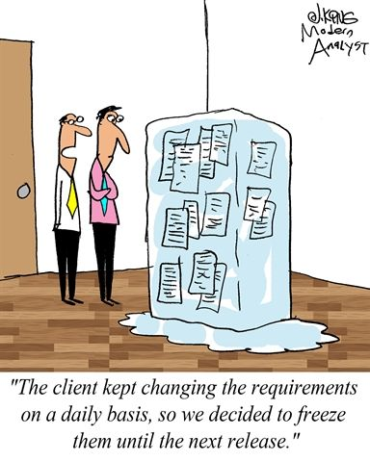
Requirements engineering processes
Processes to “generate” all requirements
Generic activities common to all processes
Requirements elicitation;
Requirements analysis;
Requirements validation;
Requirements management.
In practice, RE is an iterative activity
Notes:
The processes used for RE vary widely depending on the application domain, the people involved and the organisation developing the requirements.
However, there are a number of generic activities common to all processes
Requirements elicitation;
Requirements analysis;
Requirements validation;
Requirements management.
In practice, RE is an iterative activity in which these processes are interleaved.

Slide 27
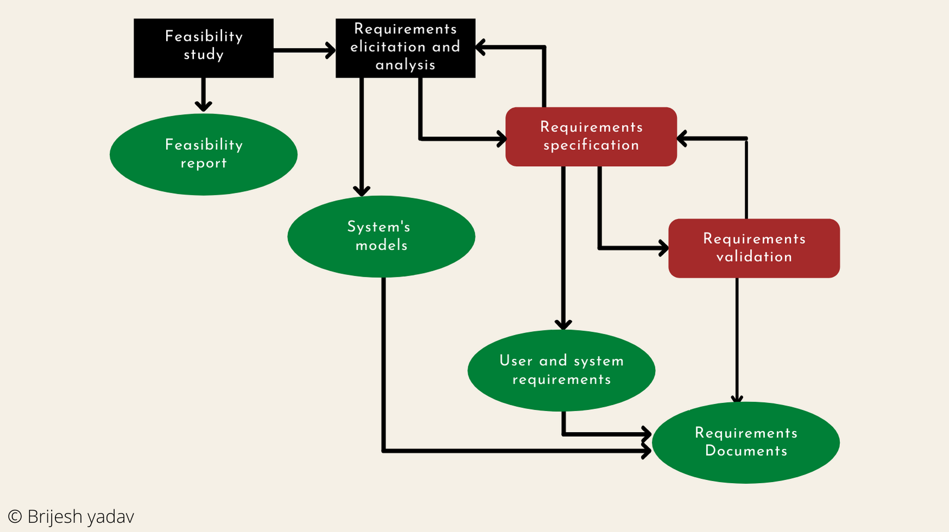
A typical view of the process

Slide 28
A spiral view of the process

Slide 29
Topics covered
Course’s project – UWC 2.0
Functional and non-functional requirements
Requirements engineering processes
Requirements elicitation
Requirements specification
Requirements validation
Requirements change

Slide 30
Requirements elicitation and analysis
~ requirements elicitation or requirements discovery.
Work with customers to find out:
the application domain, the services and the operational constraints (system performance, hardware constraints, etc.).
May involve
end-users, managers, engineers involved in maintenance, domain experts, trade unions, etc. These are called stakeholders.
Notes:
Involves technical staff working with customers to find out about the application domain, the services that the system should provide and the system’s operational constraints.
May involve end-users, managers, engineers involved in maintenance, domain experts, trade unions, etc. These are called stakeholders.
Software engineers work with a range of system stakeholders to find out about the application domain, the services that the system should provide, the required system performance, hardware constraints, other systems, etc.
Stages include:
Requirements discovery,
Requirements classification and organization,
Requirements prioritization and negotiation,
Requirements specification.

Slide 31
Problems of requirements elicitation
Stakeholders don’t know what they really want.
Stakeholders express requirements in their own terms.
Different stakeholders may have conflicting requirements.
Organisational and political factors may influence the system requirements.
The requirements change during the analysis process.
New stakeholders may emerge and the business environment change.
Notes:
Stakeholders often don’t know what they want from a computer system except in the most general terms; they may find it difficult to articulate what they want the system to do; they may make unrealistic demands because they don’t know what is and isn’t feasible.
Stakeholders in a system naturally express requirements in their own terms and with implicit knowledge of their own work. Requirements engineers, without experience in the customer’s domain, may not understand these requirements.
Different stakeholders have different requirements and they may express these in different ways. Requirements engineers have to discover all potential sources of requirements and discover commonalities and conflict.
Political factors may influence the requirements of a system. Managers may demand specific system requirements because these will allow them to increase their influence in the organization.
The economic and business environment in which the analysis takes place is dynamic. It inevitably changes during the analysis process. The importance of particular requirements may change. New requirements may emerge from new stakeholders who were not originally consulted.

Slide 32
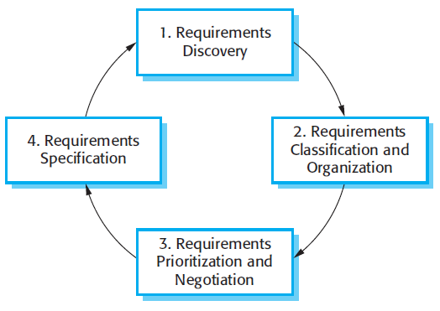
The requirements elicitation and analysis process
Interacting with stakeholders to discover their requirements.
Requirements are documented and input into the next round
Groups related requirements and organises them into coherent clusters
Prioritising requirements and resolving conflicts
Notes:
1. Requirements discovery
This is the process of interacting with stakeholders of the system to discover their requirements. Domain requirements from stakeholders and documentation are also discovered during this activity. There are several complementary techniques that can be used for requirements discovery.
2. Requirements classification and organization
This activity takes the unstructured collection of requirements, groups related requirements, and organizes them into coherent clusters. The most common way of grouping requirements is to use a model of the system architecture to identify sub-systems and to associate requirements with each sub-system. In practice, requirements engineering and architectural design cannot be completely separate activities.
3. Requirements prioritization and negotiation
Inevitably, when multiple stakeholders are involved, requirements will conflict. This activity is concerned with prioritizing requirements and finding and resolving requirements conflicts through negotiation. Usually, stakeholders have to meet to resolve differences and agree on compromise requirements.
4. Requirements specification
The requirements are documented and input into the next round of the spiral. Formal or informal requirements documents may be produced.

Slide 33
Requirements discovery
To gather information about the required and existing systems and distil the user and system requirements from this information.
Main concerns:
Stakeholders
Discovery techniques/approaches/…
Notes:
Requirement discovery = The process of gathering information about the required and existing systems and distilling the user and system requirements from this information.
Interaction is with system stakeholders from managers to external regulators.
Systems normally have a range of stakeholders.

Slide 34

Discovery technique - Interviewing
Part of most RE processes.
Types of interview
Closed vs Open => mixed?
Be effective
Be open-minded, avoid pre-conceived ideas about the requirements and are willing to listen to stakeholders.
Prompt the interviewee to get discussions going using a springboard question, a requirements proposal, or by working together on a prototype system.
Notes:
Formal or informal interviews with stakeholders are part of most RE processes.
Types of interview
Closed interviews based on pre-determined list of questions
Open interviews where various issues are explored with stakeholders.
Effective interviewing
Be open-minded, avoid pre-conceived ideas about the requirements and are willing to listen to stakeholders.
Prompt the interviewee to get discussions going using a springboard question, a requirements proposal, or by working together on a prototype system.
In practice
Normally a mix of closed and open-ended interviewing.
Interviews are good for getting an overall understanding of what stakeholders do and how they might interact with the system.
Interviews are not good for understanding domain requirements
Requirements engineers cannot understand specific domain terminology;
Some domain knowledge is so familiar that people find it hard to articulate or think that it isn’t worth articulating.
Problems with interviews
Application specialists may use language to describe their work that isn’t easy for the requirements engineer to understand.
Interviews are not good for understanding domain requirements
Requirements engineers cannot understand specific domain terminology;
Some domain knowledge is so familiar that people find it hard to articulate or think that it isn’t worth articulating.

Slide 35
Discovery technique - Ethnography
Observational technique
used to understand operational processes and help derive support requirements for these processes
How
A social scientist spends a considerable time observing and analysing how people actually work.
People do not have to explain or articulate their work.
Social and organisational factors of importance may be observed.
Notes:
Ethnography is an observational technique that can be used to understand operational processes and help derive support requirements for these processes
Ethnographic studies have shown that work is usually richer and more complex than suggested by simple system models.
Scope of ethnography
Requirements that are derived from the way that people actually work rather than the way in which process definitions suggest that they ought to work.
Requirements that are derived from cooperation and awareness of other people’s activities.
Awareness of what other people are doing leads to changes in the ways in which we do things.
Ethnography is effective for understanding existing processes but cannot identify new features that should be added to a system.
Focused ethnography
Developed in a project studying the air traffic control process
Combines ethnography with prototyping
Prototype development results in unanswered questions which focus the ethnographic analysis.
The problem with ethnography is that it studies existing practices which may have some historical basis which is no longer relevant.

Slide 36
Requirement elicitation techniques
Suggested elicitation techniques by project characteristics
Notes:
A focus group is a representative group of users who convene in a facilitated elicitation activity to generate input and ideas on a product’s functional and quality requirements
They are particularly valuable if you are developing commercial products and don’t have ready access to end users within your company.

Slide 37
Topics covered
Course’s project – UWC 2.0
Functional and non-functional requirements
Requirements engineering processes
Requirements elicitation
Requirements specification
Requirements validation
Requirements change

Slide 38
exercise: 15 mins (+ 10 mins break)
Watch the clip: https://www.youtube.com/watch?v=J9p47AO0Xco
Imagine that each employee will install a new Messenger App as a part of the UWC 2.0 system.
Task:
Identify the stakeholders of the app
Specify 03 functional requirements, at least one functional requirement extracted from the clip. Write them in a natural language approach
Specify 02 non-functional requirements you can think of! Make sure they are testable!
Document your answers:
https://docs.google.com/spreadsheets/d/1JAkNwICIopl4gjk_0cP9fJq-54TS1zc004gb3Q5mahI/edit?usp=sharing

Slide 39
Chapter 4 – Requirements Engineering
Anh Nguyen-Duc
Tho Quan Thanh

Slide 40
Topics covered
Course’s project – UWC 2.0
Functional and non-functional requirements
Requirements engineering processes
Requirements elicitation
Quality of requirements
Requirements specification
Requirement in Agile
Requirements validation
Requirements change

Slide 41
Example of nightmare requirements
The system shall perform at the maximum rating at all times except that in emergencies it shall be capable of providing up to 125% rating unless the emergency condition continues for more than 15 minutes in which case the rating shall be reduced to 105% but in the event that only 95% can be achieved then the system shall activate a reduced rating exception and shall maintain the rating within 10% of the stated values for a minimum of 30 minutes.
More than one requirement in a paragraph
Rambling: like a novel
Vague terms: emergencies

Slide 42
Another example of nightmare requirements
The system shall provide general word processing facilities which shall be easy to use by untrained staff and shall run on a thin Ethernet Local Area Network wired into the overhead ducting with integrated interface cards housed in each system together with additional memory if that should be necessary.
More than one requirement in a paragraph
Rambling: like a novel
Let-out clauses: if that should be necessary
Vague words: be easy to use, additional memory

Slide 43
Use cases
Notation | Description
Graphical notations | Graphical models, supplemented by text annotations (best for functional requirements); UML use case and sequence diagrams are commonly used.
Use-cases are a kind of scenario
identify the actors in an interaction and which describe the interaction itself
Included in the UML
A set of use cases should describe all possible interactions with the system.
UML sequence diagrams may be used to add detail to use-cases
show the sequence of event processing in the system
Notes:
Use-cases are a kind of scenario that are included in the UML.
Use cases identify the actors in an interaction and which describe the interaction itself.
A set of use cases should describe all possible interactions with the system.
High-level graphical model supplemented by more detailed tabular description (see Chapter 5).
UML sequence diagrams may be used to add detail to use-cases by showing the sequence of event processing in the system.

Slide 44
Completeness
Definition of the responses of the software to all realizable classes of input data in all realizable classes of situations (IEEE Std).
All possible situations must be covered
“If X then….”, “If Y then….” Must also consider what will happen “If neither X nor Y…”

Slide 45

Completeness (cont’)
Automatic door opener
If the door is closed and a person is detected, then send signal Open_Door.
If no person is detected after 10 sec., send signal Close_Door.
What are missing?

Slide 46
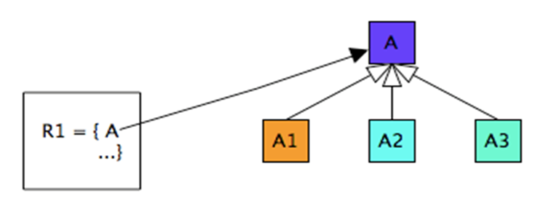
Unambiguous
A software requirement is unambiguous, if and only if, every requirement stated therein has only one interpretation (IEEE Std).
Ambiguity: Requirement with terms or statements that can be interpreted in different ways.

Slide 47
Unambiguous (cont’)
Requirement of autonomous cruise control (ACC) system is:
The maximum speed of a vehicle in a busy road shall be 10 mph.
Ambiguity: What type of vehicle do you mean?
What is busy road?

Slide 48
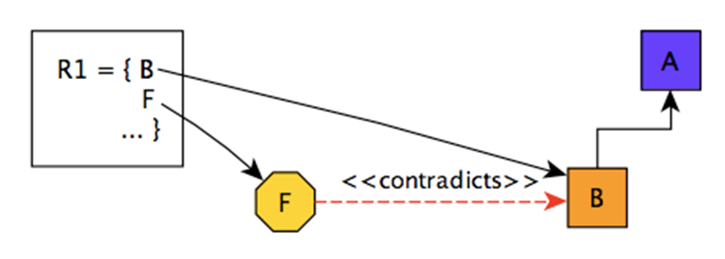
Consistent
A software requirement is internally consistent if, and only if, no subset of individual requirements described in is conflict.

Slide 49
Consistent (cont’)
Two requirements of the PROFIBUS network are in conflict
The PROFIBUS shall have a short reaction time of 60ms
PROFIBUS used in hazardous area shall have a low power dissipation of 3.6W
Conflict: Fast PROFIBUS has to have a high power

Slide 50
Main types of conflicts
Three main types of conflicts in software requirements
Specific characteristics of real-world objects
The logical or temporal conflict between two actions
Different terms for describing the same real-world object
Consistency is a challenge since we, at least in the general case, need a complete overview of all requirements that are related to the same event, function, or parameter.
Notes:
The specified characteristics of real-world objects may conflict. For example, the format of an output report may be described in one requirement as tabular but in another as textual or one requirement may state that all lights shall be green while another may state that all lights shall be blue.
There may be logical or temporal conflict between two specified actions. For example, one requirement may specify that the program will add two inputs and another may specify that the program will multiply them or one requirement may state that “A" must always follow “B", while another may require that “A and B" occur simultaneously.
Two or more requirements may describe the same real-world object but use different terms for that object. For example, a program’s request for a user input may be called a “prompt" in one requirement and a “cue" in another. The use of standard terminology and definitions promotes consistency.

Slide 51
Correct
Possible incorrect requirements
Forward referencing
Opacity
Noise
Etc.

Slide 52
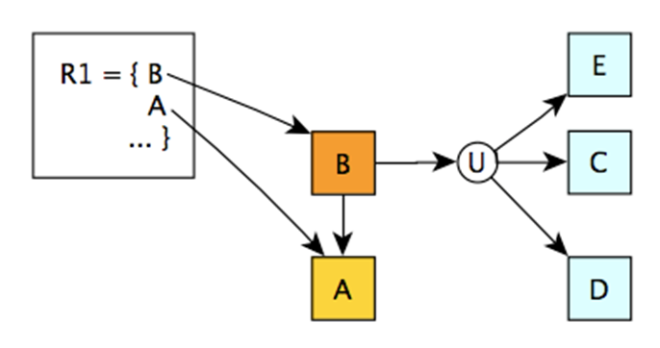
Forward referencing
Requirement items that make use of problem world domain features that are not yet defined.
E, C, and D need to be mapped to a requirement item

Slide 53
Forward referencing (cont’)
A requirement of autonomous cruise control (ACC) system is:
ACC system shall maintain the preset speed of an ego-vehicle if there is no forward vehicle.
Missing inference
Who sets the preset speed?
What is the value of the preset speed?

Slide 54
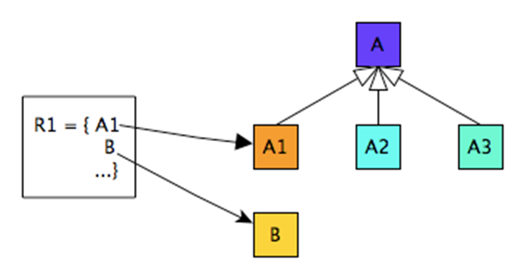
Opacity
Requirement items for which rational or dependencies are invisible.
Multiple unrelated concept mapping. A is not related to B

Slide 55
Opacity (cont’)
Requirement:
Each time the freight train (Freight trains are trains used for carrying goods) doors are closed, the passengers must all seated.
Opacity
There is no visible relationship between the freight trains and passengers.

Slide 56
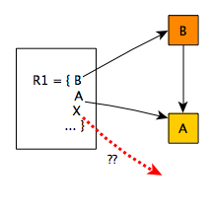
Noise
Requirement items that yield no information on problem world features.
X refers to a concept undefined in the domain

Slide 57
Noise (cont’)
Requirement: The train system shall guarantee safe transportation of all passengers on their residence.
Noise
A residence is an unknown concept within the train domain
The train can only transport passengers to the train station and not to their residence

Slide 58
Topics covered
Course’s project – UWC 2.0
Functional and non-functional requirements
Requirements engineering processes
Requirements elicitation
Quality of requirements
Requirements specification
Requirement in Agile
Requirements validation
Requirements change

Slide 59
Requirements specification

Slide 60
Requirements specification
The process of writing down the user and system requirements in a requirements document.
Notes:
User requirements have to be understandable by end-users and customers who do not have a technical background.
System requirements are more detailed requirements and may include more technical information.
The requirements may be part of a contract for the system development
Notes:
Ideally,
the user and system requirements should be clear, unambiguous, easy to understand, complete, and consistent. In practice, this is difficult to achieve as stakeholders interpret the requirements in different ways and there are often inherent conflicts and inconsistencies in the requirements.
the system requirements should simply describe the external behavior of the system and its operational constraints. They should not be concerned with how the system should be designed or implemented.
Requirements and design
In principle,
requirements should state what the system should do
and the design should describe how it does this.
In practice, requirements and design are inseparable
A system architecture may be designed to structure the requirements;
The system may inter-operate with other systems that generate design requirements;
The use of a specific architecture to satisfy non-functional requirements may be a domain requirement.

Slide 61
Ways of writing a system requirements specification
Notation | Description
Natural language | Sentences in natural language. Each sentence should express one requirement.
Structured natural language | Natural language statements on a standard form or template
Design description languages | Uses a language like a programming language, but with more abstract features
Graphical notations | Graphical models, supplemented by text annotations (best for functional requirements); UML use case and sequence diagrams are commonly used.
Mathematical specifications | Based on mathematical concepts such as finite-state machines or sets; Can reduce the ambiguity but hard to understand (and hard to check manually)
Notes:
Natural language
The requirements are written using numbered sentences in natural language. Each sentence should express one requirement.
Structured natural language
The requirements are written in natural language on a standard form or template. Each field provides information about an aspect of the requirement.
Design description languages
This approach uses a language like a programming language, but with more abstract features to specify the requirements by defining an operational model of the system. This approach is now rarely used although it can be useful for interface specifications.
Graphical notations
Graphical models, supplemented by text annotations, are used to define the functional requirements for the system; UML use case and sequence diagrams are commonly used.
Mathematical specifications
These notations are based on mathematical concepts such as finite-state machines or sets. Although these unambiguous specifications can reduce the ambiguity in a requirements document, most customers don’t understand a formal specification. They cannot check that it represents what they want and are reluctant to accept it as a system contract

Slide 62
Ways of writing a system requirements specification
Notation | Description
Natural language | Sentences in natural language. Each sentence should express one requirement.
Waste collection is often designated to an organization that provides professional waste management services. A typical waste collection process involves (1) back officers, who operate a central system to create calendar, coordinate front collectors and janitors ,(2) collectors, who drive different types of vehicles and (3) janitors who manually collect garbage from Major Collecting Points (MCPs). Calendar and tasks were assigned among teams of janitors and coordinated by back officers. These assignments are often arranged in a weekly basic. Back officers also plan which vehicles to use and their routes. This planning activity happens every month. Everyday, the back officers sent messages with information about collecting route and time to collectors and janitors. Janitors use trollers (see Figure 1b) to collect garbage in their assigned areas and deliver to the MCPs. Collectors will pick up garbage from all janitors at an MCP. One collector drives only one vehicle during his working shift. The collector will drive through several MCPs with a predetermined route by back officers.
Notes:
Natural language
The requirements are written using numbered sentences in natural language. Each sentence should express one requirement.
Structured natural language
The requirements are written in natural language on a standard form or template. Each field provides information about an aspect of the requirement.
Design description languages
This approach uses a language like a programming language, but with more abstract features to specify the requirements by defining an operational model of the system. This approach is now rarely used although it can be useful for interface specifications.
Graphical notations
Graphical models, supplemented by text annotations, are used to define the functional requirements for the system; UML use case and sequence diagrams are commonly used.
Mathematical specifications
These notations are based on mathematical concepts such as finite-state machines or sets. Although these unambiguous specifications can reduce the ambiguity in a requirements document, most customers don’t understand a formal specification. They cannot check that it represents what they want and are reluctant to accept it as a system contract

Slide 63
Ways of writing a system requirements specification
Notation | Description
Natural language | Sentences in natural language. Each sentence should express one requirement.
Used for writing requirements because it is expressive, intuitive and universal.
The requirements can be understood by users and customers.
Problems
Lack of clarity: Precision is difficult without making the document difficult to read.
Requirements confusion: Functional and non-functional requirements tend to be mixed-up.
Requirements amalgamation: Several different requirements may be expressed together.
Notes:
Natural language
The requirements are written using numbered sentences in natural language. Each sentence should express one requirement.
Structured natural language
The requirements are written in natural language on a standard form or template. Each field provides information about an aspect of the requirement.
Design description languages
This approach uses a language like a programming language, but with more abstract features to specify the requirements by defining an operational model of the system. This approach is now rarely used although it can be useful for interface specifications.
Graphical notations
Graphical models, supplemented by text annotations, are used to define the functional requirements for the system; UML use case and sequence diagrams are commonly used.
Mathematical specifications
These notations are based on mathematical concepts such as finite-state machines or sets. Although these unambiguous specifications can reduce the ambiguity in a requirements document, most customers don’t understand a formal specification. They cannot check that it represents what they want and are reluctant to accept it as a system contract

Slide 64
Structured specifications
Notation | Description
Structured natural language | Natural language statements on a standard form or template
Writing on a standard form or template:
Name
Inputs, outputs
The information needed for the computation
Action
Pre and post conditions (if appropriate)
The side effects (if any)
Writing in a boiler plate template
Notes:
Form-based specification
Definition of the function or entity.
Description of inputs and where they come from.
Description of outputs and where they go to.
Information about the information needed for the computation and other entities used.
Description of the action to be taken.
Pre and post conditions (if appropriate).
The side effects (if any) of the function.

Slide 65
A structured specification of a requirement for an insulin pump
Insulin Pump/Control Software/SRS/3.3.2
Function | Compute insulin dose: safe sugar level
Description | Computes the dose of insulin to be delivered when the current measured sugar level is in the safe zone between 3 and 7 units.
Inputs | Current sugar reading (r2); the previous two readings (r0 and r1).
Source | Current sugar reading from sensor. Other readings from memory.
Outputs | CompDose—the dose in insulin to be delivered
Destination | Main control loop.
Action | CompDose is zero if the sugar level is stable or falling or if the level is increasing but the rate of increase is decreasing. If the level is increasing and the rate of increase is increasing, then CompDose is computed by dividing the difference between the current sugar level and the previous level by 4 and rounding the result. If the result, is rounded to zero then CompDose is set to the minimum dose that can be delivered.
Requirements | Two previous readings so that the rate of change of sugar level can be computed
Pre-condition | The insulin reservoir contains at least the maximum allowed single dose of insulin.
Post-condition | r0 is replaced by r1 then r1 is replaced by r2.
Side effects | None
Notes:
Insulin Pump/Control Software/SRS/3.3.2
Function Compute insulin dose: safe sugar level
Description Computes the dose of insulin to be delivered when the current measured sugar level is in the safe zone between 3 and 7 units.
Inputs Current sugar reading (r2); the previous two readings (r0 and r1).
Source Current sugar reading from sensor. Other readings from memory.
Outputs CompDose—the dose in insulin to be delivered
Destination Main control loop.
Action CompDose is zero if the sugar level is stable or falling or if the level is increasing but the rate of increase is decreasing. If the level is increasing and the rate of increase is increasing, then CompDose is computed by dividing the difference between the current sugar level and the previous level by 4 and rounding the result. If the result, is rounded to zero then CompDose is set to the minimum dose that can be delivered.
Requirements Two previous readings so that the rate of change of sugar level can be computed
Pre-condition The insulin reservoir contains at least the maximum allowed single dose of insulin.
Post-condition r0 is replaced by r1 then r1 is replaced by r2.
Side effects None

Slide 66
Tabular specification
Particularly useful when you have to define a number of possible alternative courses of action.
Example:
Condition | Action
Sugar level falling (r2 < r1) | CompDose = 0
Sugar level stable (r2 = r1) | CompDose = 0
Sugar level increasing and rate of increase decreasing ((r2 – r1) < (r1 – r0)) | CompDose = 0
Sugar level increasing and rate of increase stable or increasing ((r2 – r1) ≥ (r1 – r0)) | CompDose = round ((r2 – r1)/4) If rounded result = 0 then CompDose = MinimumDose
Notes:
Tabular specification
Used to supplement natural language.
Particularly useful when you have to define a number of possible alternative courses of action.
For example, the insulin pump systems bases its computations on the rate of change of blood sugar level and the tabular specification explains how to calculate the insulin requirement for different scenarios.

Slide 67
Characteristics of good software requirements specification*
Complete
Unambiguous
Consistent
Correct
Verifiable
Traceable
Ranked for importance and/or stability
Modifiable
* IEEE Std 830-1998

Slide 68
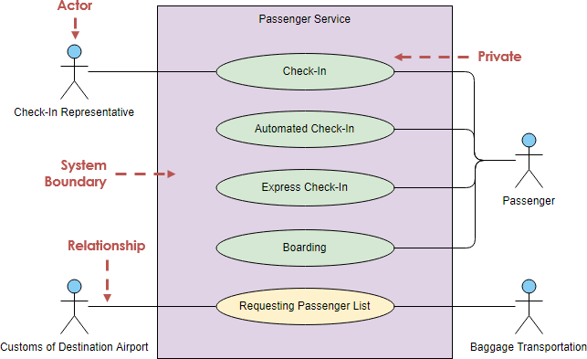
Use case diagram
Actors
Use cases
Association
System boundary boxes
Partial use case diagram for the Chemical Tracking System (CTS)
Notes:
The names of use cases are always written
UML Use Case Diagrams can be used to describe the functionality of a system in a horizontal way. That is, rather than merely representing the details of individual features of your system, UCDs can be used to show all of its available functionality.
You should use UCDs to represent the functionality of your system from a top-down perspective (that is, at a glance the system's functionality is obvious, but all descriptions are at a very high level. Further detail can later be added to the diagram to elucidate interesting points in the system's behavior.) Example: A UCD is well suited to the task of describing all of the things that can be done with a database system, by all of the people who might use it (administrators, developers, data entry personnel.) in the form of a verb followed by an object
You should NOT use UCDs to represent exception behavior (when errors happen) or to try to illustrate the sequence of steps that must be performed in order to complete a task. Use Sequence diagrams to show these design features. Example: A UCD would be poorly suited to describing the TCP/IP network protocol, because there are many exception cases, branching behaviors, and conditional functionality (what happens when a packet is lost or late, what about when the connection dies?)
https://www.andrew.cmu.edu/course/90-754/umlucdfaq.html

Slide 69
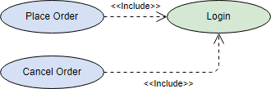
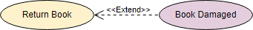
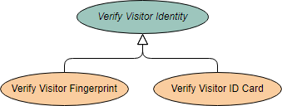
Use case diagram
Association types
Partial use case diagram for the Chemical Tracking System (CTS)
Notes:
https://online.visual-paradigm.com/diagrams/tutorials/use-case-diagram-tutorial/

Slide 70
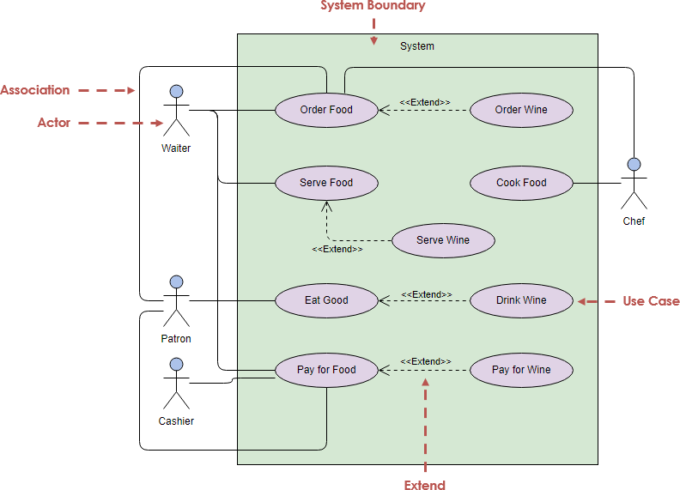
Use case diagram
Association types
Partial use case diagram for the Chemical Tracking System (CTS)
Notes:
https://online.visual-paradigm.com/diagrams/tutorials/use-case-diagram-tutorial/

Slide 71
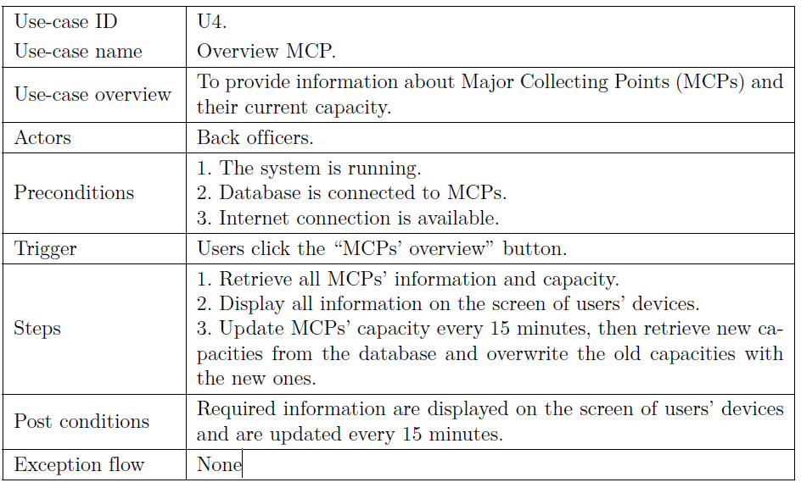
Use case template and example

Slide 72
Draw a use-case diagram for the whole UWC 2.0 system (not only the Task management module)
https://docs.google.com/presentation/d/1NNqqt_LuHjvWQGs5ifE6s88UPA77fG6cmTzmY0oIULU/edit#slide=id.p

Slide 73
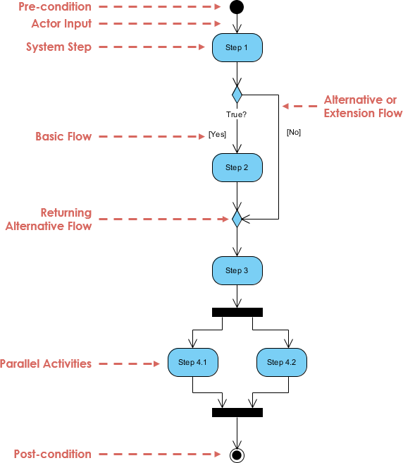
Activity diagram
Identify candidate use cases, through the examination of business workflows
Identify pre- and post-conditions (the context) for use cases
Model workflows between/within use cases
Model complex workflows in operations on objects
Model in detail complex activities in a high level activity Diagram

Slide 74
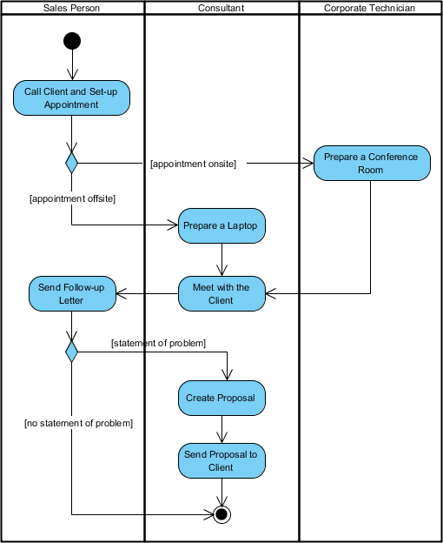
Activity diagram
https://www.visual-paradigm.com/guide/uml-unified-modeling-language/what-is-activity-diagram/

Slide 75
Sequence diagram
an interaction diagram that details how operations are carried out -- what messages are sent and when
Sequence diagrams are organized according to time.

Slide 76
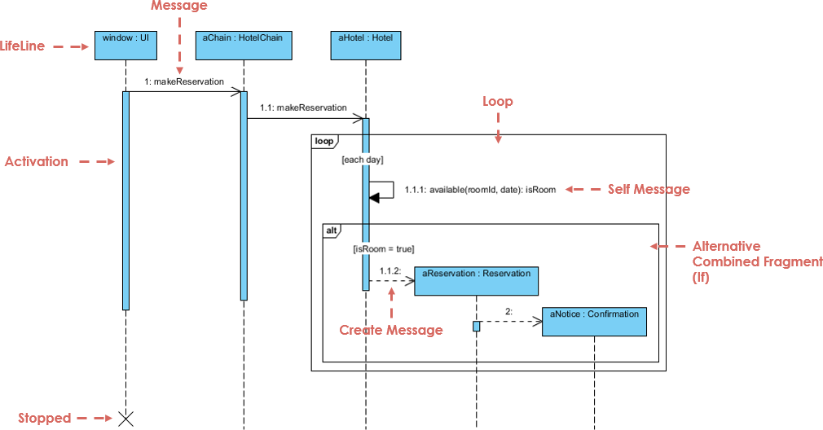
Sequence diagram

Slide 77
Topics covered
Course’s project – UWC 2.0
Functional and non-functional requirements
Requirements engineering processes
Requirements elicitation
Quality of requirements
Requirements specification
Requirement in Agile
Requirements validation
Requirements change

Slide 78
Agile methods and requirements
Many Agile methods argue that producing detailed system requirements is a waste of time as requirements change so quickly.
The requirements document is therefore always out of date.
Agile methods usually use incremental requirements engineering and may express requirements as ‘user stories’
This is practical for business systems but problematic for systems that require pre-delivery analysis (e.g. critical systems) or systems developed by several teams.
Notes:
Many agile methods argue that producing detailed system requirements is a waste of time as requirements change so quickly.
The requirements document is therefore always out of date.
Agile methods usually use incremental requirements engineering and may express requirements as ‘user stories’
This is practical for business systems but problematic for systems that require pre-delivery analysis (e.g. critical systems) or systems developed by several teams.

Slide 79
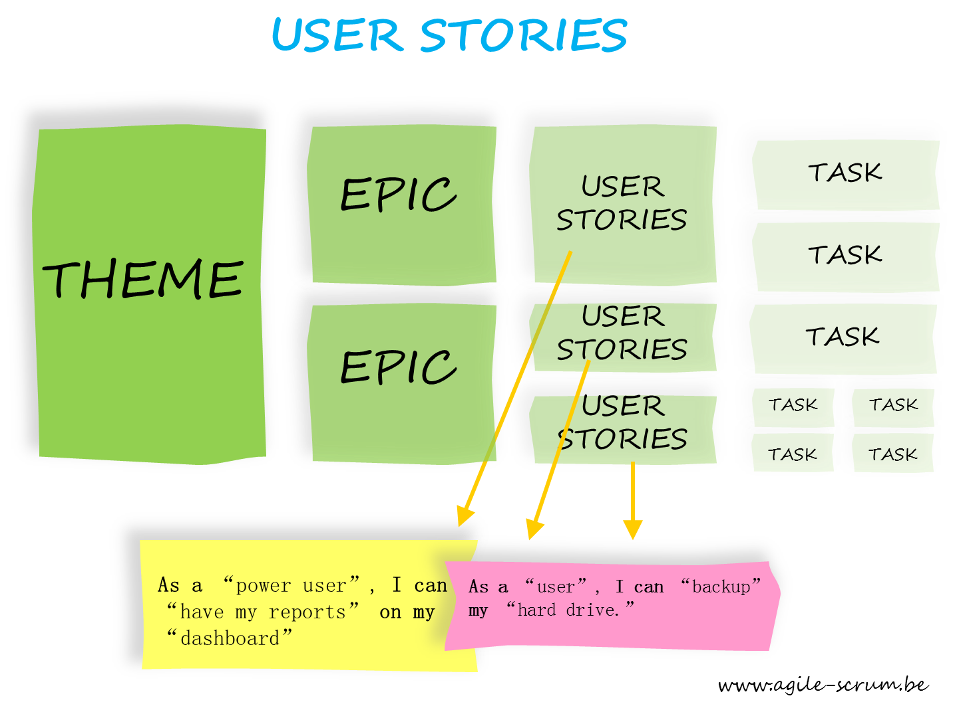
Agile methods and requirements – USER STORY

Slide 80
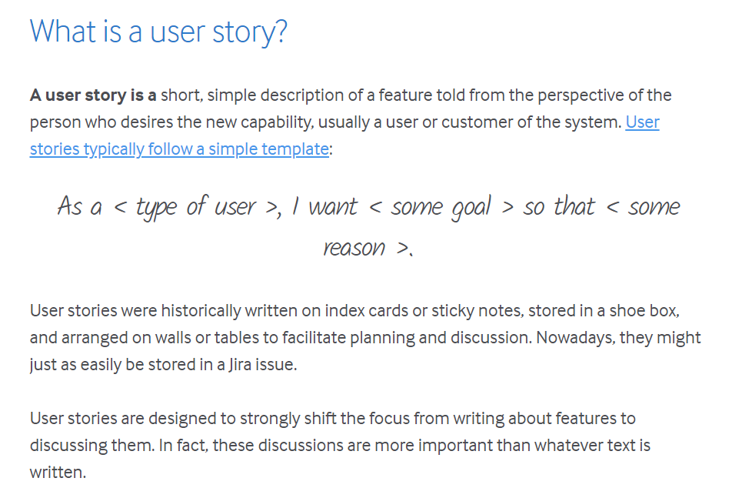
USEr story
Notes:
Tabular specification
Used to supplement natural language.
Particularly useful when you have to define a number of possible alternative courses of action.
For example, the insulin pump systems bases its computations on the rate of change of blood sugar level and the tabular specification explains how to calculate the insulin requirement for different scenarios.

Slide 81
Agile methods and requirements – USER STORY
As a medical record stuff, I wish to view current medication from primary care general practice
As a medical receptionist, I want to search appointments by patients’ first name, their telephone number, their date of birth or their prescribed medicine
As a healthcare manager, I want to see the monthly report including number of prescribed medicines ordered by their categories, by weeks, and by cost

Slide 82
MORE about Non-Functional Requirements (NFR)
Many definitions can be found of NFR
A NFR is basically an attribute of or a constraint on a system ^{[1]}
Attributes
-ilities: understandability, reliability, portability, flexibility, availability, maintainability, scalability, …
-ities: security, simplicity, clarity, ubiquity, integrity, safety, modularity, …
-ness: user-friendliness, robustness, timeliness, responsiveness, …
Constraint
Physical
Environmental
Legal
Cultural
...

Slide 83
ISO/IEC 25010 product quality model
The ISO model is a factor – criteria – metrics model. Only the first two levels are shown in the diagram.
System/software Product Quality
Characteristic/Factor
Sub-characteristic/Criteria
Functional Suitability
Performance efficiency
Compatibility
Usability
Reliability
Security
Maintainability
Portability
Functional completeness
Functional correctness
Functional appropriateness
Time behaviour
Resource utilisation capacity
Co-existence
Interoperability
Appropriateness
Recognisability
Learnability
Operability
User error protection
User interface aesthetics
Accessability
Maturity
Availability
Fault tolerance
Recoverability
Confidentially
Integrity
Non-repudiation
Accountability
Authenticity
Moduality
Reusability
Analysability
Modifiability
Testability
Adaptability
Installability
Replaceability

Slide 84
Topics covered
Course’s project – UWC 2.0
Functional and non-functional requirements
Requirements engineering processes
Requirements elicitation
Quality of requirements
Requirements specification
Requirement in Agile
Requirements validation
Requirements change

Slide 85
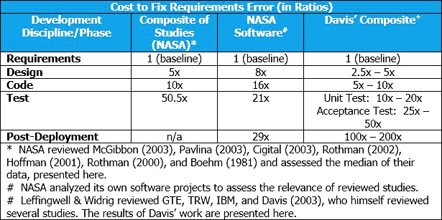
Requirements validation
Requirements error can be costly !
Notes:
Concerned with demonstrating that the requirements define the system that the customer really wants.
Requirements error costs are high so validation is very important
Fixing a requirements error after delivery may cost up to 100 times the cost of fixing an implementation error.
Requirement validation overlaps with requirement analysis as it is concerned with finding problems with the requirements.
Requirements validation is important because errors in a requirements document can lead to extensive rework costs when these problems are discovered during development or after the system is in service.

Slide 86
Requirements checking
Validity.
Does the system provide the functions which best support the customer’s needs?
Consistency.
Are there any requirements conflicts?
Completeness.
Are all functions required by the customer included?
Realism.
Can the requirements be implemented given available budget and technology
Verifiability.
Can the requirements be checked?
Notes:
1. Validity checks
A user may think that a system is needed to perform certain functions. However, further thought and analysis may identify additional or different functions that are required. Systems have diverse stakeholders with different needs and any set of requirements is inevitably a compromise across the stakeholder community.
2. Consistency checks
Requirements in the document should not conflict. That is, there should not be contradictory constraints or different descriptions of the same system function.
3. Completeness checks
The requirements document should include requirements that define all functions and the constraints intended by the system user.
4. Realism checks
Using knowledge of existing technology, the requirements should be checked to ensure that they can actually be implemented. These checks should also take account of the budget and schedule for the system development.
5. Verifiability
To reduce the potential for dispute between customer and contractor, system requirements should always be written so that they are verifiable. This means that you should be able to write a set of tests that can demonstrate that the delivered system meets each specified requirement.

Slide 87
Requirements validation techniques
Requirements reviews
Systematic manual analysis of the requirements.
Prototyping
Using an executable model of the system to check requirements.
Test-case generation
Developing tests for requirements to check testability.
Notes:
1. Requirements reviews
The requirements are analyzed systematically by a team of reviewers who check for errors and inconsistencies.
2. Prototyping
In this approach to validation, an executable model of the system in question is demonstrated to end-users and customers. They can experiment with this model to see if it meets their real needs.
3. Test-case generation
Requirements should be testable. If the tests for the requirements are devised as part of the validation process, this often reveals requirements problems. If a test is difficult or impossible to design, this usually means that the requirements will be difficult to implement and should be reconsidered. Developing tests from the user requirements before any code is written is an integral part of extreme programming.
Requirement Reviews
Regular reviews should be held while the requirements definition is being formulated.
Both client and contractor staff should be involved in reviews.
Reviews may be formal (with completed documents) or informal. Good communications between developers, customers and users can resolve problems at an early stage.
Review checks
Verifiability
Is the requirement realistically testable?
Comprehensibility
Is the requirement properly understood?
Traceability
Is the origin of the requirement clearly stated?
Adaptability
Can the requirement be changed without a large impact on other requirements?

Slide 88
Topics covered
Course’s project
Functional and non-functional requirements
Requirements engineering processes
Requirements elicitation
Quality of requirements
Requirements specification
Requirement in Agile
Requirements validation
Requirements change

Slide 89
Changing requirements
The business and technical environment of the system always changes after installation.
The people who pay for a system and the users of that system are rarely the same people.
Large systems usually have a diverse user community, with many users having different requirements and priorities that may be conflicting or contradictory.
Notes:
New requirements emerge as a system is being developed and after it has gone into use.
The business and technical environment of the system always changes after installation.
New hardware may be introduced, changing the interface with other systems, business priorities may change, and new legislation and regulations may be introduced.
The people who pay for a system and the users of that system are rarely the same people.
System customers impose requirements because of organizational and budgetary constraints. These may conflict with end-user requirements and, after delivery, new features may have to be added for user support if the system is to meet its goals.
Large systems usually have a diverse user community, with many users having different requirements and priorities that may be conflicting or contradictory.
The final system requirements are inevitably a compromise between them and, with experience, it is often discovered that the balance of support given to different users has to be changed.
We need to keep track of individual requirements and maintain links between dependent requirements so that you can assess the impact of requirements changes.
We need to establish a formal process for making change proposals and linking these to system requirements.

Slide 90
Requirements management
Requirements management is the process of managing changing requirements during the requirements engineering process and system development.
New requirements emerge as a system is being developed and after it has gone into use.
You need to keep track of individual requirements and maintain links between dependent requirements so that you can assess the impact of requirements changes. You need to establish a formal process for making change proposals and linking these to system requirements.

Slide 91
Requirements management planning
Establishes the level of requirements management detail that is required.
Requirements management decisions:
Requirements identification
A change management process
Traceability policies
Tool support
Notes:
Requirements management decisions:
Requirements identification Each requirement must be uniquely identified so that it can be cross-referenced with other requirements.
A change management process This is the set of activities that assess the impact and cost of changes. I discuss this process in more detail in the following section.
Traceability policies These policies define the relationships between each requirement and between the requirements and the system design that should be recorded.
Tool support Tools that may be used range from specialist requirements management systems to spreadsheets and simple database systems.

Slide 92
Requirements change management
Deciding if a requirements change should be accepted
Problem analysis and change specification
Change analysis and costing
Change implementation
Notes:
Problem analysis and change specification
During this stage, the problem or the change proposal is analyzed to check that it is valid. This analysis is fed back to the change requestor who may respond with a more specific requirements change proposal, or decide to withdraw the request.
Change analysis and costing
The effect of the proposed change is assessed using traceability information and general knowledge of the system requirements. Once this analysis is completed, a decision is made whether or not to proceed with the requirements change.
Change implementation
The requirements document and, where necessary, the system design and implementation, are modified. Ideally, the document should be organized so that changes can be easily implemented.

Slide 93
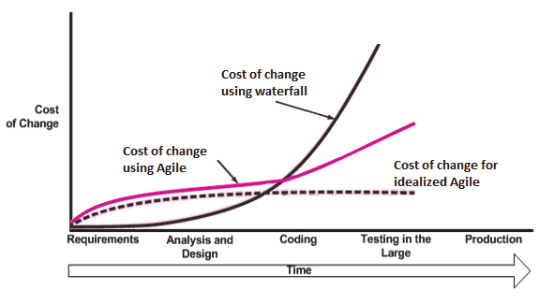
Response to change: AGILE approach!

Slide 94
Summary
Requirements: what the system should do and constraints on its operation and implementation.
Functional requirements = the services
Non-functional requirements = constraints (development & use)
apply to the system as a whole.
The software requirements document (i.e. SRS) is an agreed statement of the system requirements.
The RE process is an iterative process
requirements elicitation, specification and validation.
Notes:
Requirements for a software system set out what the system should do and define constraints on its operation and implementation.
Functional requirements are statements of the services that the system must provide or are descriptions of how some computations must be carried out.
Non-functional requirements often constrain the system being developed and the development process being used. They often relate to the emergent properties of the system and therefore apply to the system as a whole.
The software requirements document is an agreed statement of the system requirements. It should be organized so that both system customers and software developers can use it.
The requirements engineering process is an iterative process including requirements elicitation, specification and validation.

Slide 95
Summary (cont.)
Requirements elicitation and analysis = iterative process
requirements discovery, classification and organization, negotiation and requirements documentation.
Techniques for requirements elicitation
interviews, scenarios, use-cases and ethnography, etc.
Requirements validation = checking the requirements
for validity, consistency, completeness, realism and verifiability.
Business, organizational and technical changes inevitably
=> changes to the requirements for a software system.
Requirements management = managing and controlling the requirement changes.
Notes:
Requirements elicitation and analysis is an iterative process that can be represented as a spiral of activities – requirements discovery, requirements classification and organization, requirements negotiation and requirements documentation.
You can use a range of techniques for requirements elicitation including interviews, scenarios, use-cases and ethnography.
Requirements validation is the process of checking the requirements for validity, consistency, completeness, realism and verifiability.
Business, organizational and technical changes inevitably lead to changes to the requirements for a software system. Requirements management is the process of managing and controlling these changes.

